Slide 1
3rd Grade Pars Remediation Lesson
Dorothy Hains STEM Department

Slide 2
Standards
S3L1: Students will investigate the habitats of different organisms and the how the organisms count on their habitat to provide all they need to survive.

Slide 3
Standards
b. Identify features of green plants that allow them to live and thrive in different
regions of Georgia.

Slide 4
Standards
c. Identify features of animals that allow them to live and thrive in different regions of Georgia.

Slide 5
Standards
d. Explain what will happen to an organism if the habitat is changed

Slide 6
Standards
a. Differentiate between habitats of Georgia (mountains, marsh/swamp, coast,
Piedmont, Atlantic Ocean) and the organisms that live there..

Slide 7
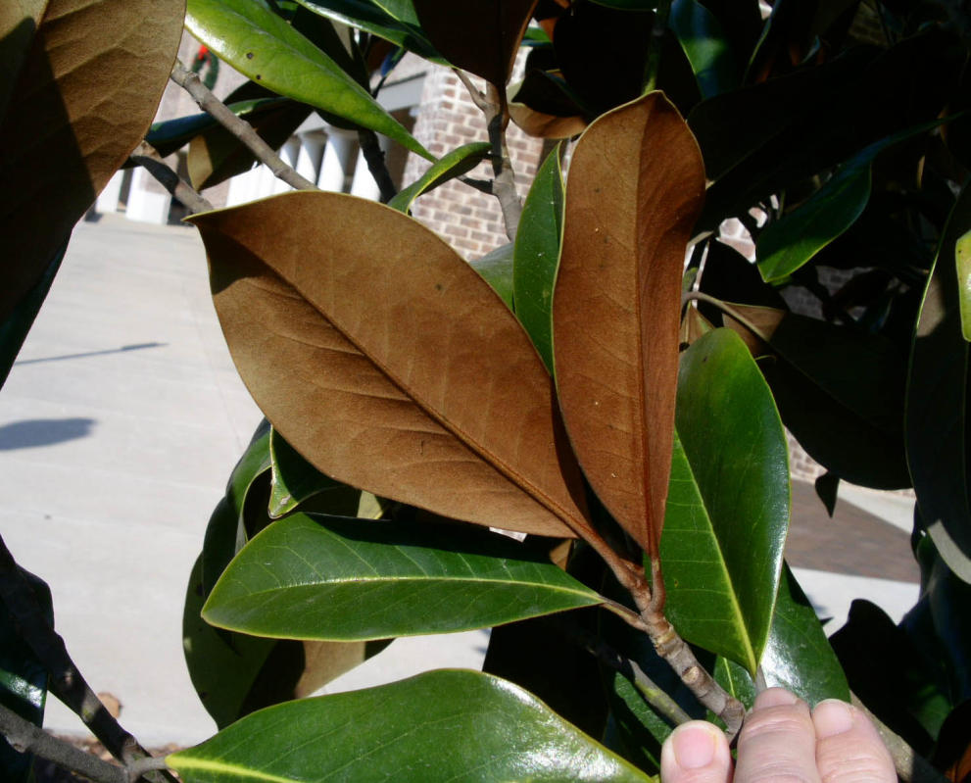
b. Identify features of green plants that allow them to live and thrive in different regions of Georgia.
Plant Adaptations
Waxy leaves help plant keep water
in

Slide 8
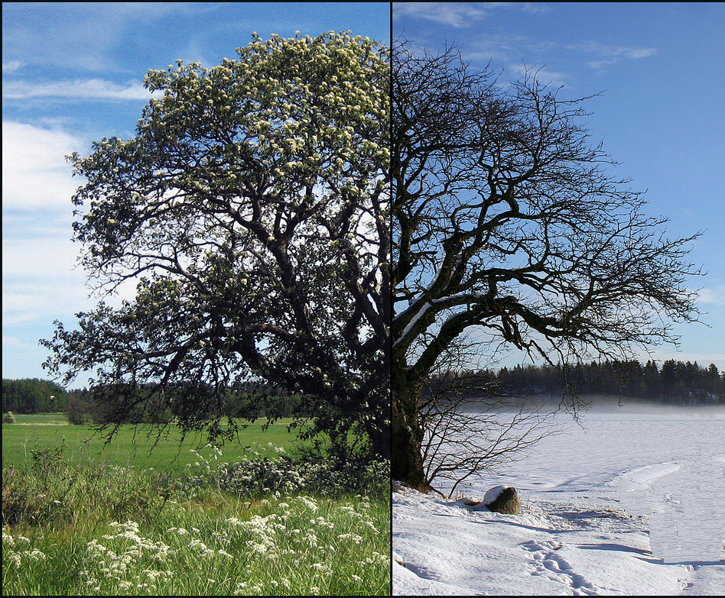
b. Identify features of green plants that allow them to live and thrive in different regions of Georgia.
Plant Adaptations
Deciduous Trees lose their leaves in the fall for winter to adapt to the cold temperatures.
Summer
Winter

Slide 9
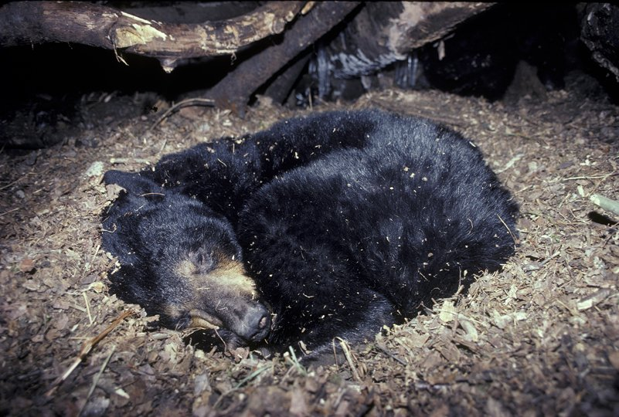
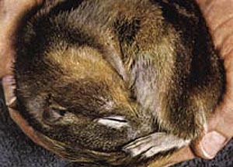
c. Identify features of animals that allow them to live and thrive in different regions of Georgia.
Animal Adaptations
Hibernation: An adaptation that allows many animals to sleep through the winter when food is not available.
Black Bear Hibernating
Squirrel Hibernating
Black Bear Hibernating

Slide 10
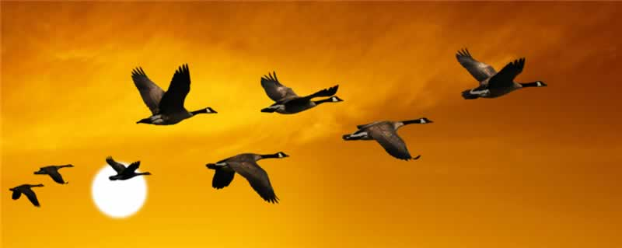
c. Identify features of animals that allow them to live and thrive in different regions of Georgia.
Animal Adaptations
Migration: An adaptation that causes many different kinds of bird to fly south to avoid winter.
Migrating Canadian Geese
Black Bear Hibernating

Slide 11
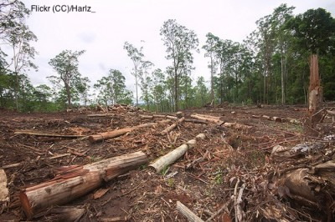
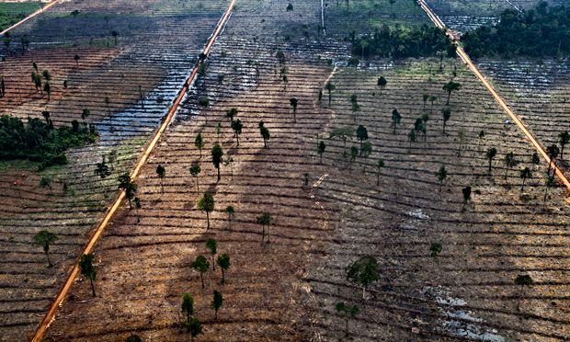
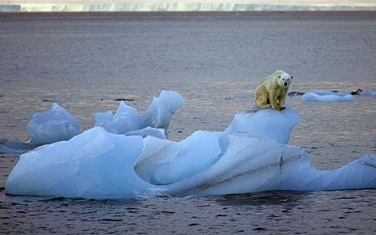
d. Explain what will happen to an organism if the habitat is changed.
Habitat Change
Cause: Lose of habitat due to humans.
Cause: Lose of habitat due to climate change.
Migrating Canadian Geese
Black Bear Hibernating

Slide 12
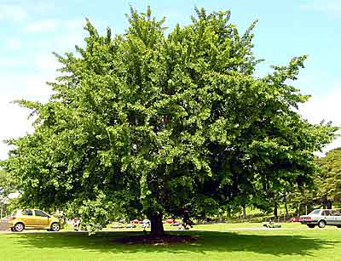
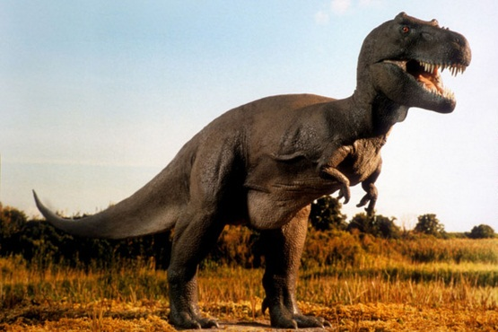
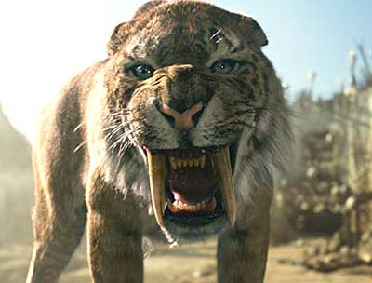
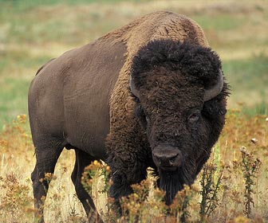
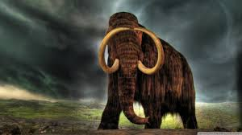
d. Explain what will happen to an organism if the habitat is changed.
Habitat Change
What happens to animals and plants when their habitat changes?: Most will die some will adapt to the change and survive.
Gingko Tree
Extinct
Adapted & Survived
Saber Tooth Tiger
Buffalo
Mammoth
Adapted & Survived
Extinct
Extinct

Slide 13
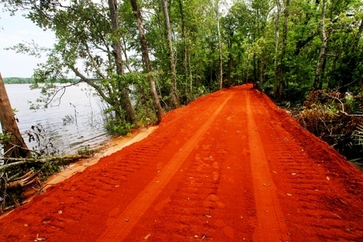
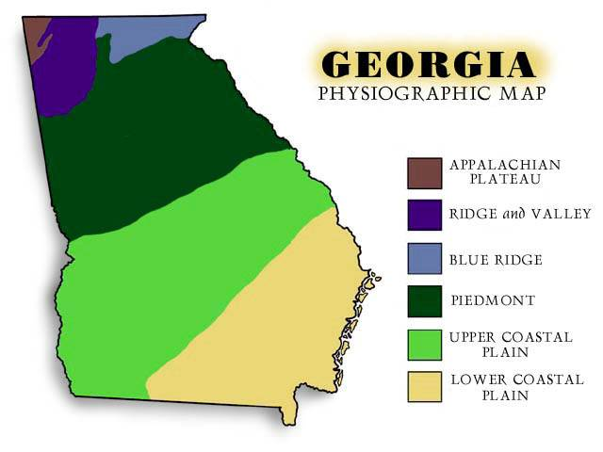
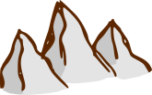
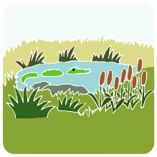
a. Differentiate between habitats of Georgia (mountains, marsh/swamp, coast, Piedmont, Atlantic Ocean) and the organisms that live there..
Regions of Georgia
Mountains
Red Clay hills in Piedmont.
Hills
Little hills mostly flat
Flat & Swamp

