Slide 1
Christmas Tree Challange
By: Dorothy Hains STEM Department

Slide 2
Table of contents
3rd-5th
Straw Tower:
Making a Dome:
Straw Rockets:
Christmas Tree:
PreK-2nd
Straw Tower:
Making a Dome:
Oobleck:
Christmas Tree:

Slide 3
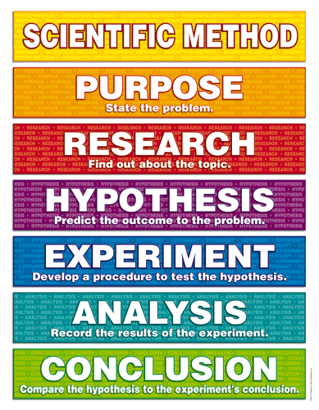

Slide 4
Essential Question
What will happen when the cardboard is placed into the ammonia, water and bluing solution?
This is your problem?

Slide 5
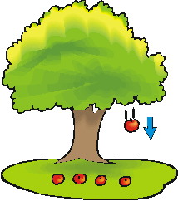
Vocabulary
Gravity: The pulling force that causes things to fall to the ground.

Slide 6
Capillary Action:The process of a liquid being drawn up “ Sucked Up,” against gravity.

Slide 7
Capillary Action:The process of a liquid being drawn up “ Sucked Up,” against gravity.

Slide 8
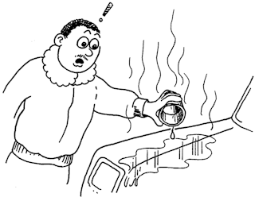
Evaporation:The process of a liquid turning into a gas.

Slide 9
Capillary Action Research Demonstration!
What will happen in the paper towel?

Slide 10
Table Wipe Demonstration:
What will happen to the small amount of water left on the table?

Slide 11
Hypothesis
I think that the ammonia,water, bluing, salt and food coloring will __________________ on the cardboard.

Slide 12
What’s the problem?
_________________________
_________________________
_________________________
Form a hypothesis. What will happen?
_________________________
_________________________
_________________________
See back of sheet
Test hypothesis. Steps to do experiment.
___________________________________
___________________________________
___________________________________
___________________________________
___________________________________
What happened? Was your hypothesis correct?
____________________________________________
____________________________________________
____________________________________________
____________________________________________
____________________________________________

Slide 13
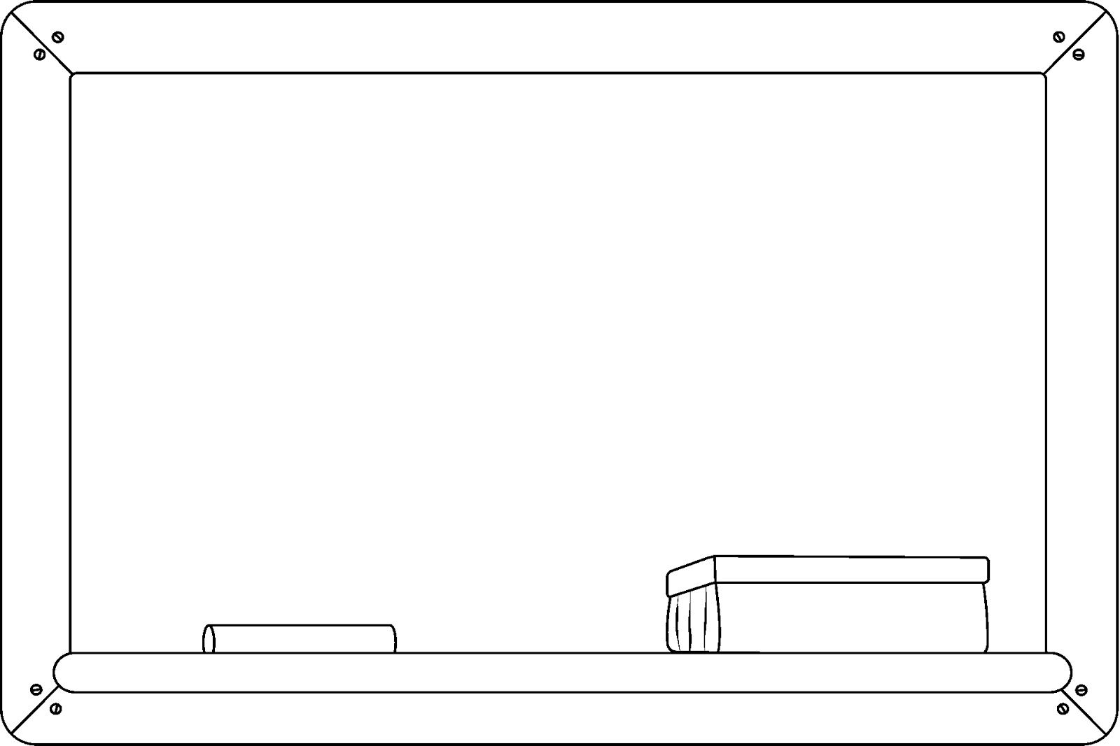
Observation 1:
____________________
____________________
____________________
____________________
____________________
____________________
Observation 2:
____________________
____________________
____________________
____________________
____________________
____________________
Observation 3:
____________________
____________________
____________________
____________________
____________________
____________________
Observation 4:
____________________
____________________
____________________
____________________
____________________
____________________

Slide 14
Vocabulary / Info
Capillary Action: The process of water being sucked up against gravity.
Gravity: The pulling force that causes things to fall to the ground.
Evaporation: The process of water turning into a gas.
NOTES:___________________________________
__________________________________________
__________________________________________
__________________________________________
__________________________________________
__________________________________________
Paper Towel & Water:
What happened?
____________________
____________________
____________________
____________________
____________________
____________________
____________________
____________________
____________________
Table Wipe:
What happened?
____________________
____________________
____________________
____________________
____________________
____________________
____________________
____________________
____________________

Slide 15
What were the results?
The cardboard sucked up the water, ammonia, bluing, salt and food coloring mixture.
The mixture evaporated leaving behind the salt, bluing and food coloring in crystals.

Slide 16
Was your hypothesis correct?
Yes, Explain!
No, Explains!

Slide 17
Essential Question
Question:
What will happen when the cardboard is placed into the ammonia, water and bluing solution?
Answer:
The mixturew will get sucked up into the cardboard and then evaporate leaving behind colored crystals.

Slide 18
Capillary Action Research Demonstration!
What will happen in the empty cup?

