Slide 1
What’s the problem?
_________________________
_________________________
_________________________
Form a hypothesis. What will happen? ______________________________
_________________________
_________________________
See back of sheet
Test hypothesis. Steps to do experiment.
______________________________
______________________________
______________________________
What happened? Was your hypothesis correct?
______________________________________
______________________________________
______________________________________

Slide 2
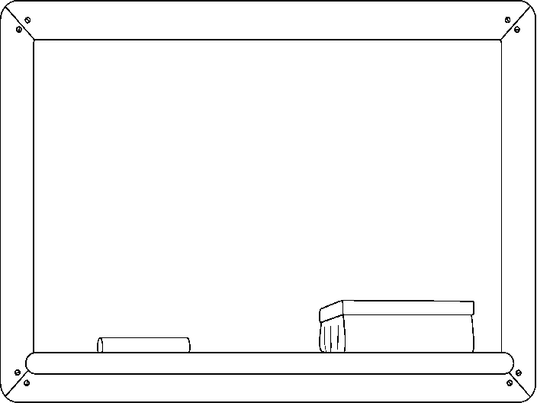
Observation 1:
__________________
__________________
__________________
__________________
____________________
____________________
Observation 2:
__________________
__________________
__________________
__________________
Observation 3:
__________________
__________________
__________________
__________________
Observation 4:
__________________
__________________
__________________
__________________

Slide 3
Vocabulary / Info
Capillary Action: The process of water being sucked up against gravity.
Gravity: The pulling force that causes things to fall to the ground.
Evaporation: The process of water turning into a gas.
NOTES:_______________________________
_____________________________________
_____________________________________
_____________________________________
_____________________________________
Paper Towel & Water:
What happened?
__________________
__________________
__________________ __________________ __________________ __________________
__________________
Table Wipe:
What happened?
__________________
__________________
__________________
__________________
__________________
__________________
__________________

