Slide 1
Straw Rocket
By: Dorothy Hains STEM Department

Slide 2
Essential Question
What changes can I make to my straw rocket that will cause it to fly the furthest?
> Tip on front
> Wings to fly
> Low weight

Slide 3
Hypothesis
I believe if we _____________________ it will cause the rocket to fly further than the rest of my classmates.

Slide 4
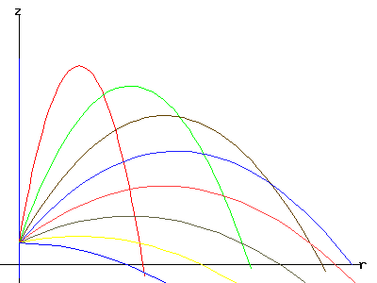
Vocabulary
Trajectory:The path followed by a projectile flying or an object moving under the action of given forces.

Slide 5
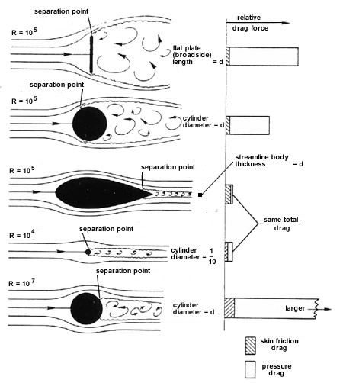
Vocabulary
Aerodynamic: Having
a shape that reduces the
drag from air moving past.

Slide 6
Name: _________________
What is the problem?
What are the constraints
 | Hypothesis | Trial 1 | Trial 2 | Trial 3 | Trial 4 | Observation & thoughts on changes to improve distance and flight stability of straw rocket.
Distance in ft & in |  | 7ft |  |  |  | tumbl
Number of fins size |  | 2 fin 1in
Cone Shape |  | flat
Rocket Body Length |  | 6in |  |  |  | `

Slide 7
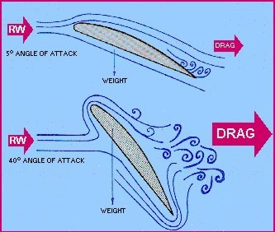
Vocabulary
Drag: A force that opposes an aircraft's motion through the air.

Slide 8
How to make the rocket body
Step 1: Measure out a 5 inch by 5 inch square and cut it out.
Step 2: Roll the paper around a pencil as tightly as you can and tape it along its body.

Slide 10
Table of contents
Straw Tower:
Making a Dome:
Straw Rockets:

