Slide 1
Intro to Genetics
DOROTHY HAINS STEM DEPARTMENT

Slide 2
STANDARDS
S5L2: Students will understand that offspring can look and act like their parents because they have inherited physical and behavioral traits.

Slide 3
ESSENTIAL QUESTIONS
What is DNA?
What is a Chromosome?
What is a Gene?
How do we inherited traits from our parents?

Slide 4
What is DNA?
DNA: DeoxyriboNucleic Acid
It contains the instruction on how to make you.
Think of it as a cook book on how to make all living things.

Slide 5
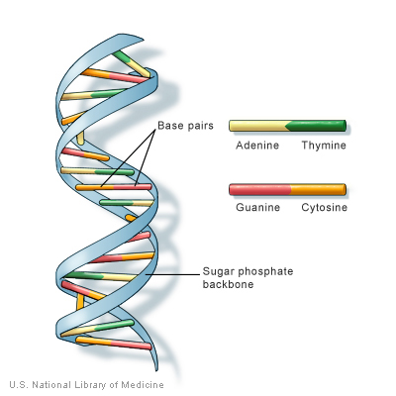
What is DNA?
DNA looks like a spiral stair case.
Each step is made of base pairs.
There are 4 different base pairs
Adenine→ Thymine
Guanine→ Cytosine
Depending on how these base pairs are ordered we get different genes.

Slide 6
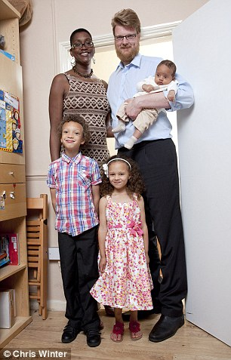
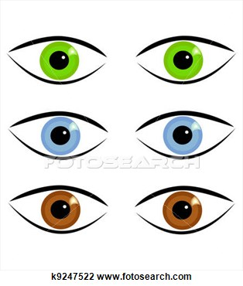
What is a Gene?
Height →
Worlds Tallest Family
A Gene is a chunk of DNA made up of base pairs that has the instructions to make a trait like…
Eye color→
Hair color →
7ft
6’5”
New born
2 ft
3, 7”
Age 4
4’7ft
Age 6

Slide 7
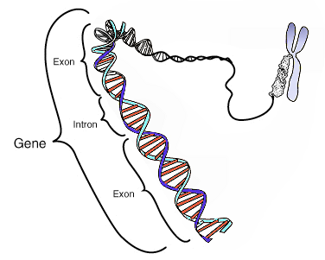
Review
A bunch of Base Pairs → make → a Gene.
A bunch of Genes make a ? Hmmmmmmm what does a bunch of Genes make…..
← Base Pairs

Slide 8
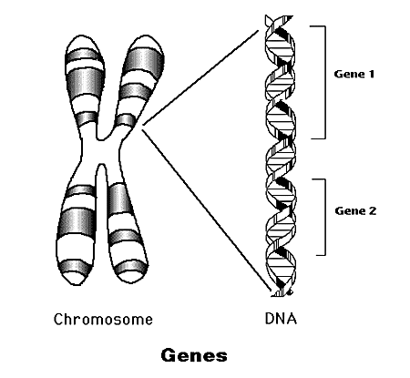
What is a Chromosome?
A bunch of Genes makes a Chromosome.
Chromosomes are huge.

Slide 9
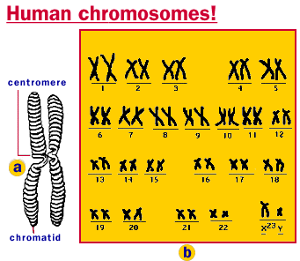
What is a Chromosome?
Human beings have 23 chromosomes contained in the nucleus of every cell in their body!

Slide 10
Review
From smallest to biggest
Base Pairs make up a Gene
Genes make up a Chromosome.
Base Pairs → Genes→ Chromosomes

Slide 11
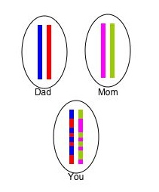
How do we inherited traits from out parents?
Your dad provides ½ of your DNA and your mom provides the other ½.
Notice how the
combine to make
you. You have your
parents DNA but it
comes together in
a 100% unique way
to make you!

Slide 12
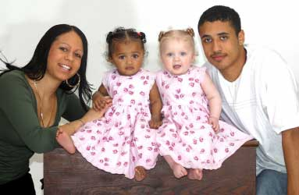
How do we inherited traits from out parents?
These are twin born to two parents of Latino heritage.
But, they both are mixed race and have one white parent.
The DNA combine in such a way that one child got mostly white physical features.

Slide 13
How do we inherited traits from out parents?
This is how it works…
Below is Punnett Square. Scientist use this to track the odds of children inheriting simple physical traits from their parents.
Lets pretend we are tracking eye color. We have a dad with brown eyes (B B) and we have mom with blue eyes (b b).
All the children will have brown
eyes because each child gets a
dominate brown eye trait from dad.
All traits have a dominate and
Recessive version. Brown is dominate
in eye color blue eyes is recessive.
Any time a dominate trait is present
means what is seen on the outside
will be the dominate trait.
However, all these children secretly
carry a blue eye trait that might come
if they have children with another person
that has blue eyes or is a secret carrier
of the trait.
b
b
b
b
b
b
B
B
B
Brown eyes
Brown eyes
B
B
B
Brown eyes
Brown eyes

Slide 14
How do we inherited traits from out parents?
In this version mom has blue eyes
(bb) and dad has brown eyes but is
a secret carrier of blue eyes (Bb)
Any time these parents have
children they have a 50% chance of
having blue or brown eyed child.
b
b
b
b
b
b
B
B
B
Brown eyes
Brown eyes
b
b
b
Blue eyes
Blue eyes

Slide 15
Assignment
Draw 4 Punnett squares→
Your teacher will give you 4 different combinations of traits for eye color.
See if you can fill out the Punnett square correctly and find the possibility as a percentage the parents will have a child of a certain eye color.
It will be 25% 50% 75% or 100%

