Slide 1
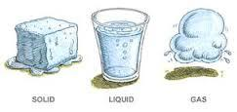
Oobleck Observation Sheet
Name: ________________________
circle one
Hypothesis: I believe oobleck is a Soild Liquid Combination state of matter becasue ______________________________________________________________________________________
Essential Question: How does oobleck act as a solid and a liquid? ____________________________________________________________________________________________________________________________________________________________________________
Test | Observation
Drip Test
Smack Test
Ooze Test
Stir Test
3 States of Matter:
______ _______ ______
Has a shape
Takes shape of its container
Fills its container

