Slide 1
Oobleck
By: Dorothy Hains STEM Department

Slide 2
Essential Question
What are the 3 states of matter?
What is oobleck and which state of matter is it in?

Slide 3
Let’s Read: Beware The Oobleck

Slide 4
Hypothesis
Oobleck is ______________ of matter because ________________________.

Slide 5
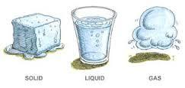
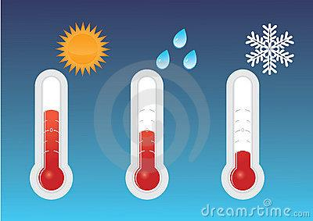
Vocabulary
Cold
Warm
Hot
3 States of Matter:
Solid
Liquid
Gas
Takes shape of its container
Has a shape
Fills its container

Slide 6
How to Make Oobleck
Step 1: Measure out 1 cup of water and add 4 drops of green food coloring.
Step 2: Measure out 1 ½ cups of cornstarch and mix with 1 cup of green dyed water till blended.

Slide 7
Vocabulary
Non-Newtonian Fluid. A substance that acts like a liquid when being poured, but like a solid when a force is acting on it.

Slide 8
EQ
Liquid: you can pour it
=Solid: when hit its hard

