Slide 1
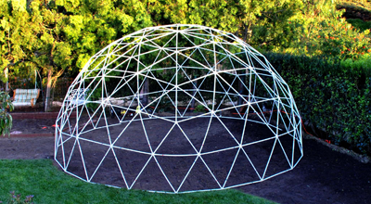
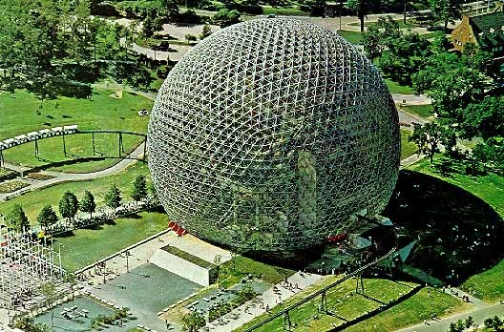
Geodesic Dome Design ChallengeMr. Bertling & Mrs. Leverett Dorothy Hains’ STEM Department

Slide 2
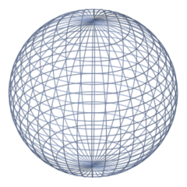
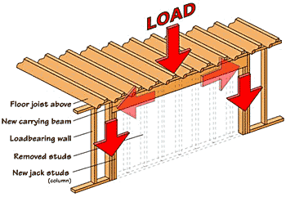
Vocabulary
Geodesic Dome: A geodesic dome is a spherical or partial-spherical shell structure or lattice shell based on a network of great circles on the surface of a sphere.
Sphere: The shape of a ball.
Support: To bear weight.
Load: A heavy thing to be carried.
Notes:
*

Slide 3
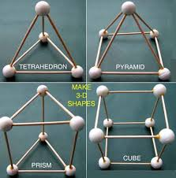

Slide 4
Design Challenge
Your groups represent different companies of architectural engineers that are competing for a contract to build a geometric dome playgroup equipment for schools and parks.
Notes:
*

Slide 5
Constraints
1.) Must use all the jellybeans in the bag
2.) Don’t have to use all of the toothpicks
3.) Geometric dome must hold enough weight that it won't collapse and hurt kids playing on it.
Notes:
*

Slide 6
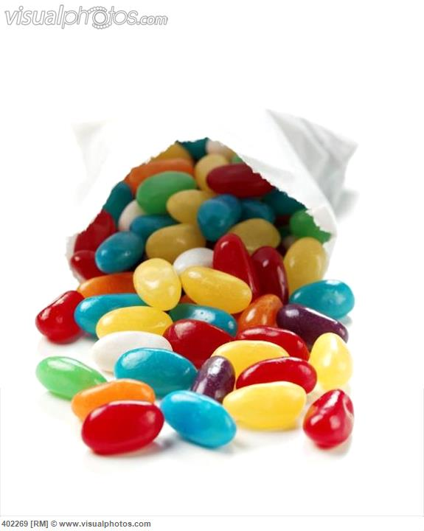
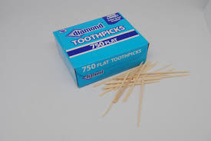
Materials
1.) Bag of jellybeans
2.) Box of toothpicks
Notes:
*

Slide 7
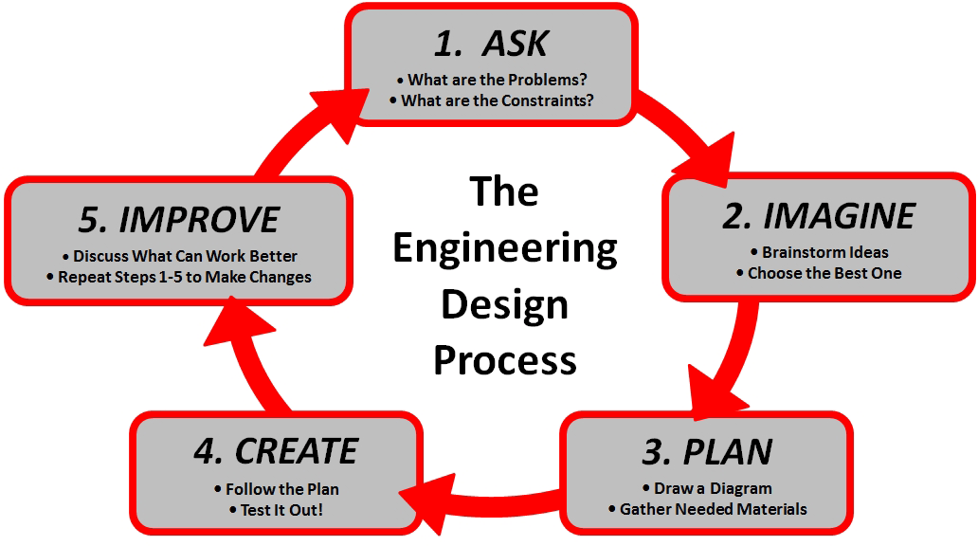
Engineering Design Process

Slide 8
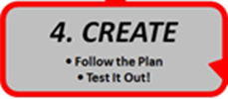
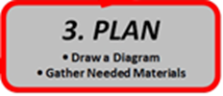
Example Planning Page
What is your problem? What are the constraints? | Draw a diagram of your geodesic dome: What shape will you repeat to make your geodesic dome? Materials: > > >
How would you improve your geodesic dome?
Results
Max Load: _____

Slide 9
Engineering Design Process

Slide 10
Closing
Who gets the contract?

