Slide 1
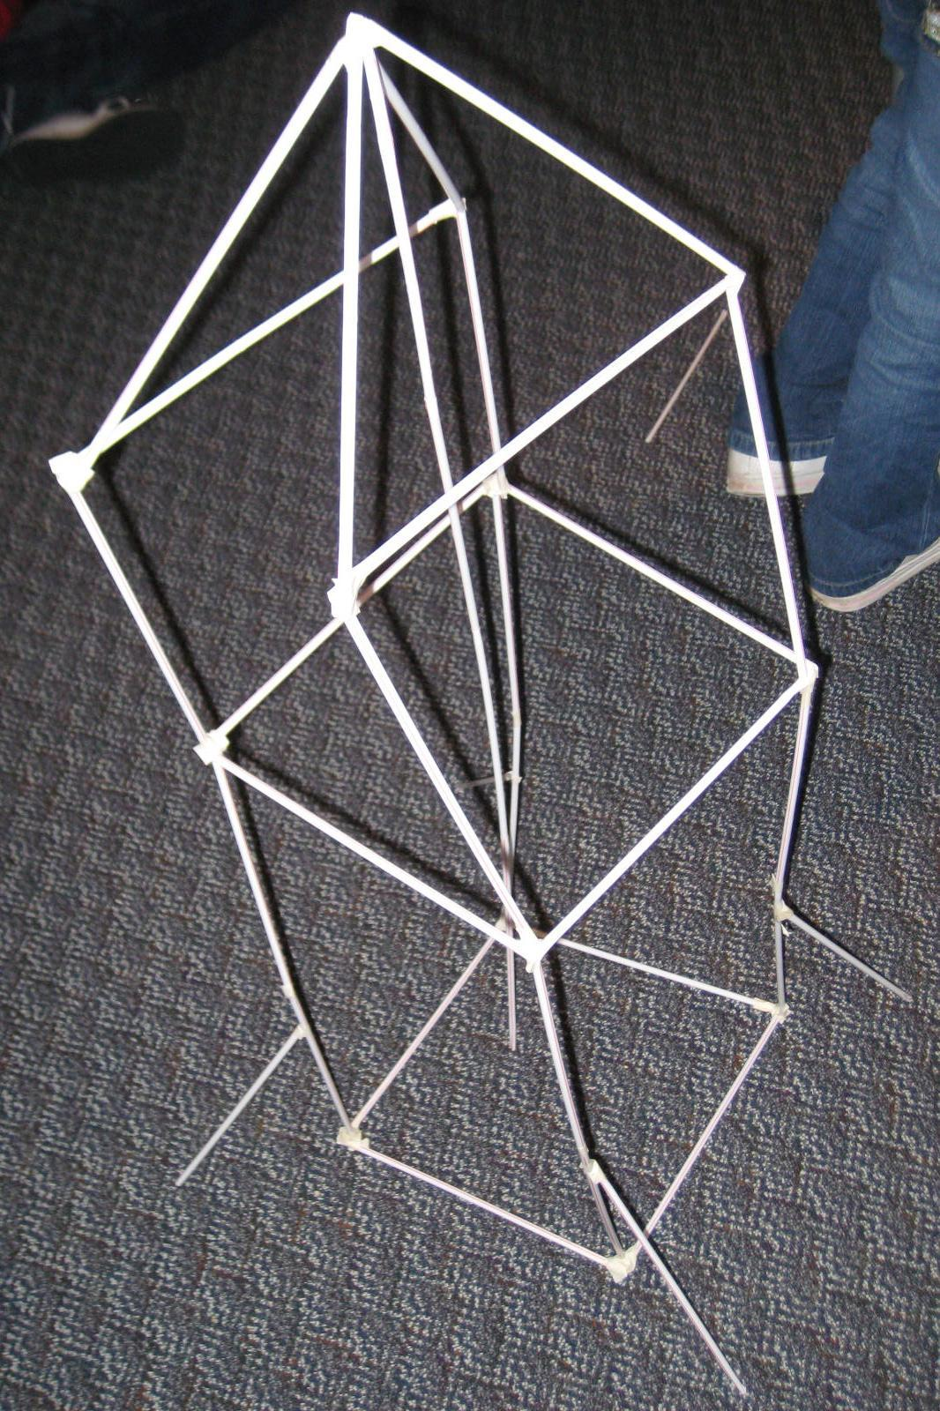
Straw Towers Design ChallengeMr. Bertling & Mrs. Leverett Dorothy Hains’ STEM Department

Slide 3
Design Challenge
You have been brought together as a team of civil engineers to construct the tallest, most stable tower. Your team’s design will be competing for a contract awarded by the city. Before you can be awarded the contract, however, you must develop a prototype of the tower you intend to build.
Notes:
*

Slide 4
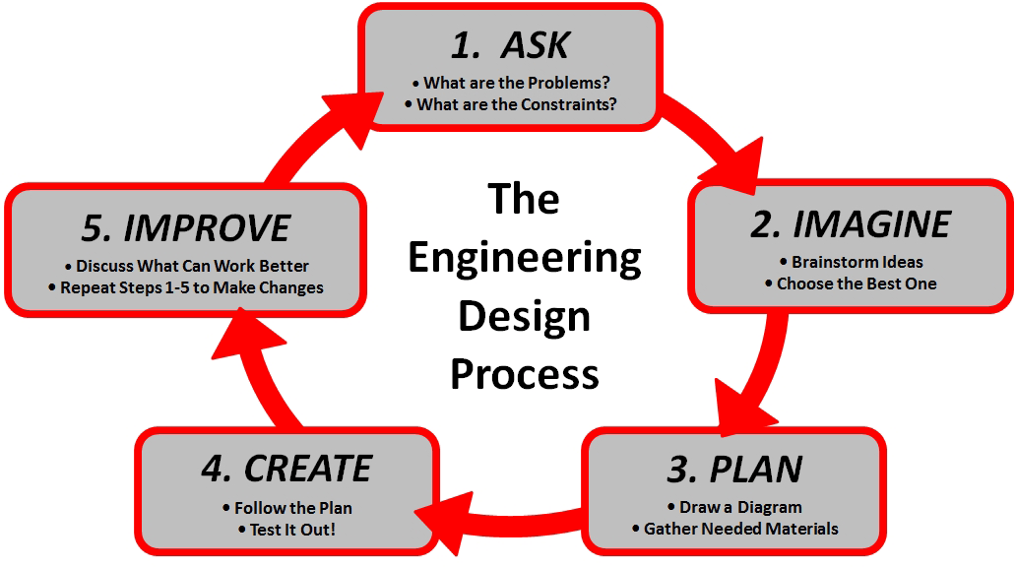
Engineering Design Process

Slide 5
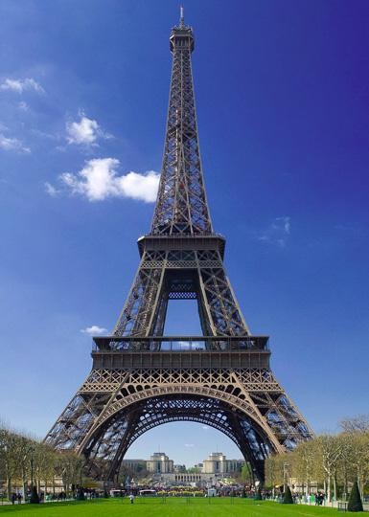
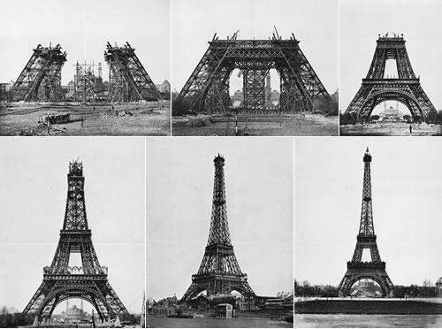
Your Task
To work together as a team to create the tallest, most stable tower using:
50 straws per team
Tape
Eiffel Tower
Paris, France

Slide 6
Time Intervals
5-7 minutes for research and development; brainstorming, talking, communicating, and sketching initial design.
Three 10 minute intervals for construction.
Two minute discussion periods at the end of each building phase.

Slide 7
Rules For Tower Construction
No taping structure to the floor or table.
Tower must be free standing upon completion.
You can’t hold it up!
Each structure will be measured from the base to the highest free standing point.
Each group can ask 2 questions during the building process pertaining to the actual design, process, or rules.

Slide 8
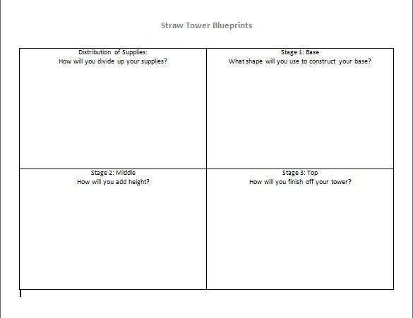
Example Planning Page

Slide 9
Alternate Teaching Strategies
Foreperson
Guide the team in making decisions.
Oversee the building of the tower.
Engineer 1
Draw Straw Tower Blueprints.
Build the tower according to the blueprints.
Engineer 2
Draw Straw Tower Blueprints.
Build the tower according to the blueprints
Financial Manager
Inventory materials.
Distribute and monitor use of materials.
Job Descriptions
Describes a specific job for each team member in order to utilize time more efficiently and to prevent arguments.

Slide 10
Foreperson Guide the team in making decisions. Oversee the building of the tower. | Engineer 1 Draw Straw Tower Blueprints. Build the tower according to the blueprints.
Engineer 2 Draw Straw Tower Blueprints. Build the tower according to the blueprints. | Financial Manager Inventory materials. Distribute and monitor use of materials.

Slide 11
Engineering Design Process

Slide 12
Closing
Who gets the contract?

