Slide 1
Water Wheel
By: Dorothy Hains STEM Department

Slide 2
Table of contents
Straw Tower:
Making a Dome:
Straw Rockets:
Water Wheel:

Slide 3
dhSTEM.weebly.com
Link

Slide 4
Essential Question | Hypothesis | Vocabulary | Design Budget
________________________________________________________________________________________________________________________________________________________________________________________________________ | ________________________________________________________________________________________________________________________________________________________________________________________________________ | ____________________ ____________________________________________________________________________________________________________________________________________________________________________________ ________________________________________________________________________________________________________________________________________________________________________________________________________ | Total Budget: $1000 Inch of tape: $25 Paper Plate: $300 We will need____inches of tape at a cost of $_______ Axel Pencil: $150 Scissors: $25 Ruler: $25 Total Spent: $_________

Slide 5
Essential Question
What is an effective water wheel design?

Slide 6
Hypothesis
I believe if I design my water wheel by_______________ it will turn when water is poured on it.

Slide 7
Design Criteria
You must use a paper plate to create a wheel that will turn when water is poured over it and raise a paper clip on string.

Slide 8
Constraints
Must use the following materials:
> paper plate
> tape
Tools:
> ruler
> scissors

Slide 9
Vocabulary
Water Wheel: A machine that converts moving water into useful energy to power things.

Slide 10
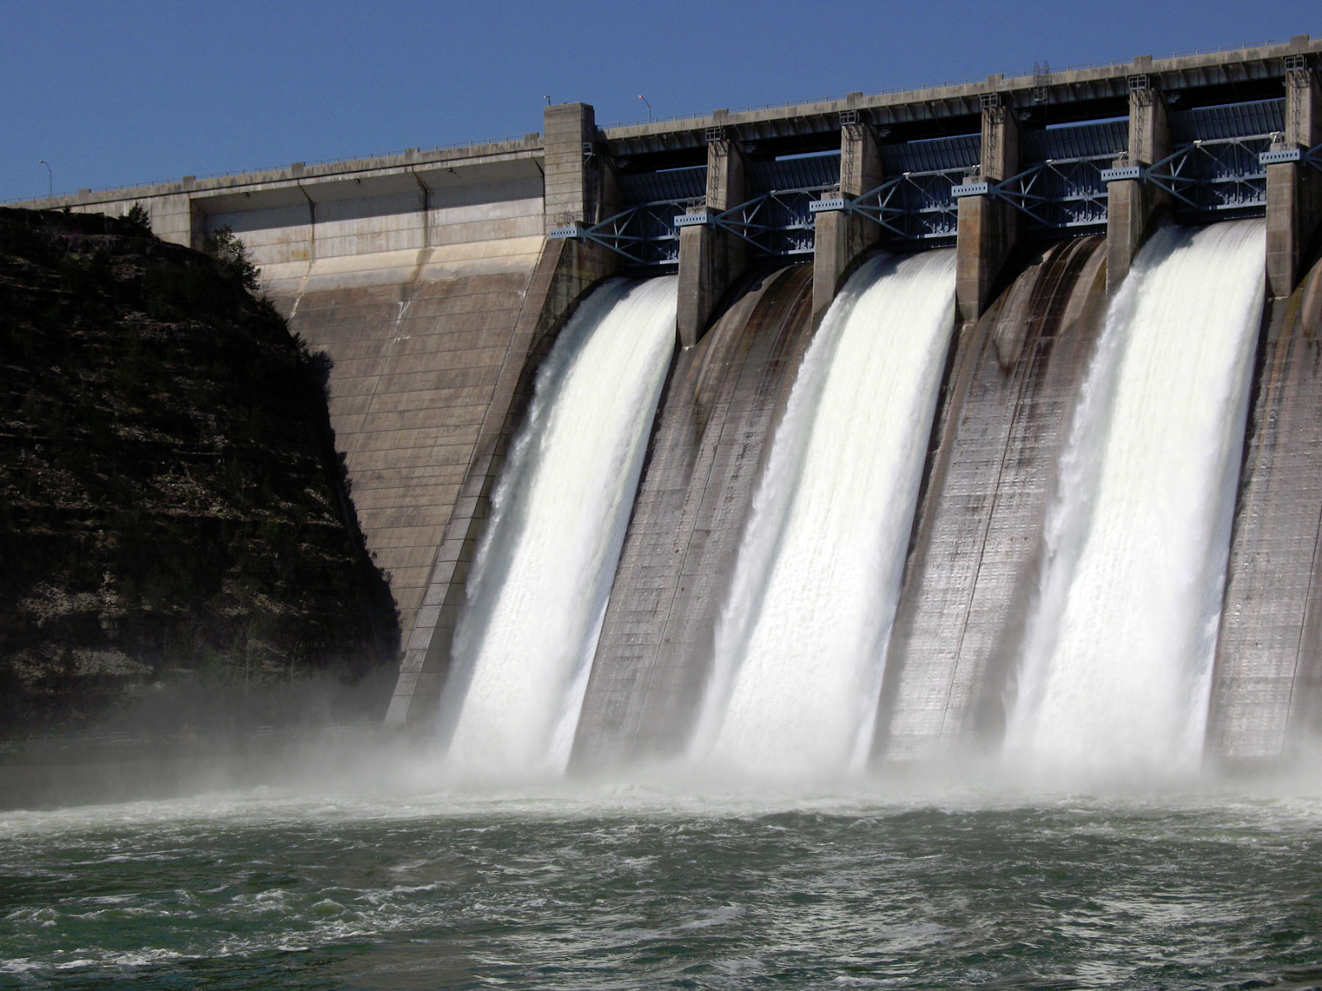
Vocabulary
Hydroelectric: Electricity produced by moving water.

Slide 11
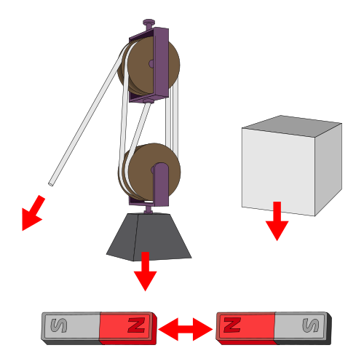
Vocabulary
Force: A push or pull on an object that results in a change of direction and/or speed.

Slide 13
What is the problem? ________________________________________________________________ Design Criteria: What must your product do? ________________________________________________________________ What are the constraints? ________________________________________________________________ | How are you going to solve the problem? | Diagram: Materials: > ______________ > ______________ > ______________ > ______________ > ______________ | Observation: ________________________________________________________________________________________________________________________________ Results: ________________________________________________________________________________________________________________________________________________________________ | What can be done to improve the design? ________________________________________________________________________________________________________________________________ Diagram:

Slide 14
Essential Question | Hypothesis | Vocabulary | Design Budget
________________________________________________________________________________________________________________________________________________________________________________________________________ | ________________________________________________________________________________________________________________________________________________________________________________________________________ | ____________________ ____________________________________________________________________________________________________________________________________________________________________________________ ________________________________________________________________________________________________________________________________________________________________________________________________________ | Total Budget: $1000 Inch of tape: $25 Paper Plate: $300 We will need____inches of tape at a cost of $_______ Axel Pencil: $150 Scissors: $25 Ruler: $25 Total Spent: $_________

Slide 15
How to make a water wheel
Step 1:

Slide 16
Closing
Essential Question:
What is an effective water wheel design?

